Slide 1
Microsoft 365 & Power Platform Development – Bi-weekly call
Your host in this call: David Warner (Microsoft)
June 23rd, 2022

Slide 2




v
Agenda
Latest on PnP Framework and Core SDK extension
Latest on PnP PowerShell
Latest on yo Teams
Latest on Microsoft Graph Toolkit
Independent Publisher Connectors
Latest on script samples
Latest Microsoft Teams samples
Latest on Power Platform samples
Picture time with the Together Mode!
André Lage - List Formatting - Tab and Percentage Chart
Federico Sapia - Keep track of your activities with Microsoft Lists and Power Automate
Sohil Bhalla - Build your own Microsoft Teams using Microsoft Graph Toolkit and .NET Core API and Integrate using Web Components

Slide 3
Opportunities to Participate in the community
Demo solution or technical pattern
Contribute on GitHub
Provide feedback
Great opportunity to get visibility for you or your company. Demo sample or explain how you extend or customize SharePoint Online with live demo in your projects. Reach out to team for volunteering.
Request a demo spot on the call
https://aka.ms/m365pnp/request/demo

Slide 4
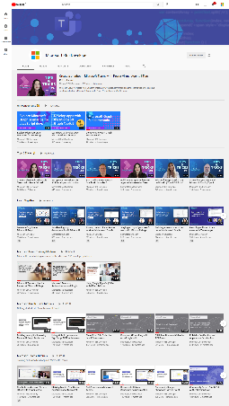
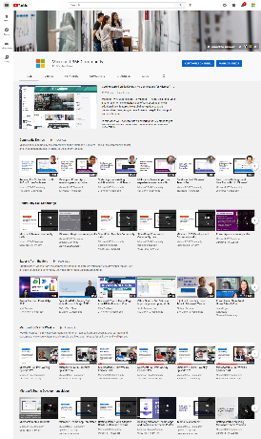
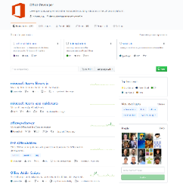
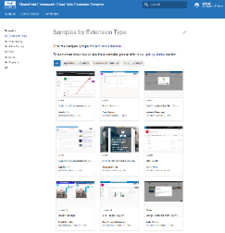
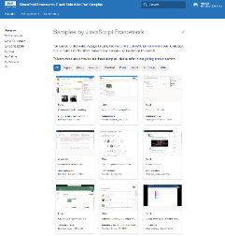
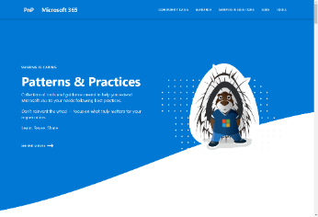
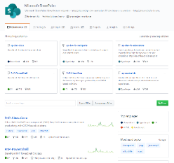
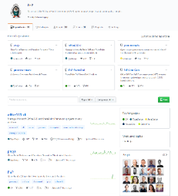
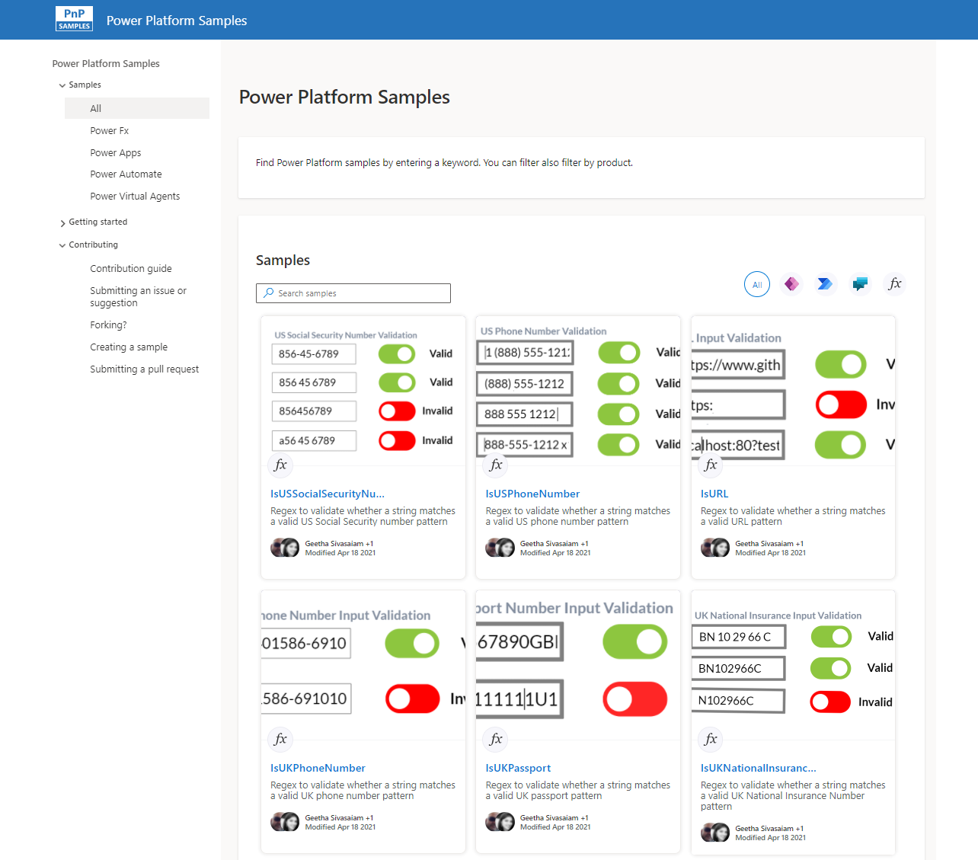
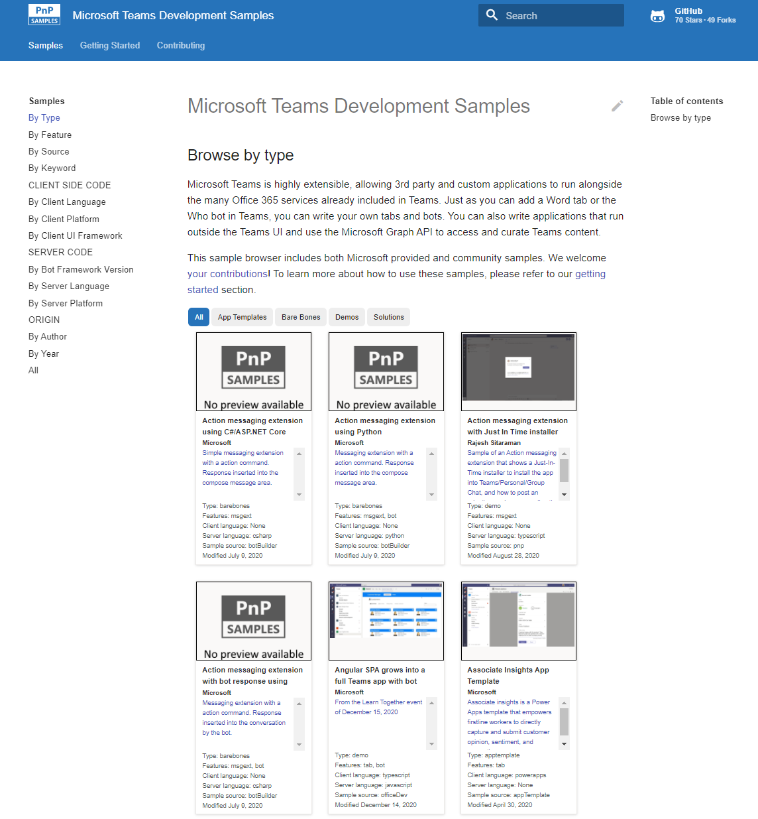
Microsoft 365 developer videos
Microsoft 365 community videos
Open-source
Sample galleries
Open-source initiatives and samples
github.com/sharepoint
github.com/pnp
github.com/officedev
github.com/microsoftgraph
aka.ms/m365/samples
aka.ms/teams-samples
aka.ms/spfx-webparts
aka.ms/powerplatform-samples
aka.ms/spfx-extensions
aka.ms/list-formatting
aka.ms/m365/community
aka.ms/m365devyoutube
aka.ms/m365pnp/videos
@Microsoft365Dev | @m365pnp

Slide 5
Microsoft 365 developer community calls
Microsoft 365 platform (weekly) https://aka.ms/m365-dev-call
(Notice. This call is on a summer break between July 1st and 31st of August 2022)
Adaptive Cards https://aka.ms/adaptivecardscommunitycall
Microsoft identity platform https://aka.ms/IDDevCommunityCalendar
Office Add-ins https://aka.ms/officeaddinscommunitycall
Power Platform https://aka.ms/PowerPlatformMonthlyCall
Microsoft 365 & Power Platform Development (bi-weekly) https://aka.ms/m365-dev-sig
Viva Connections & SharePoint Framework (bi-weekly) https://aka.ms/spdev-spfx-call
Download recurrent invites from
https://aka.ms/m365/calls
Notes:
m365-dev-sig

Slide 6







Last call before summer break 1st of July – 31st of August
Latest news from Microsoft engineering on Microsoft 365 topics
Community together mode group photo
Rabeb Othmani - Taking advantage of the Microsoft Graph postman collections
Geeta Ramakrishnan, Divyanka Malik, Malabika Roy - Introduction on the Microsoft Viva Learning extensibility
Benjamin Olson - Introduction to Virtual Appointment API
AGENDA
Microsoft 365 platform call 28th of June @ 8 AM PT
Weekly call with Microsoft presenters covering the latest Microsoft 365 platform updates
Download recurrent invite from https://aka.ms/m365-dev-call
Notes:
Dan’s slide

Slide 7
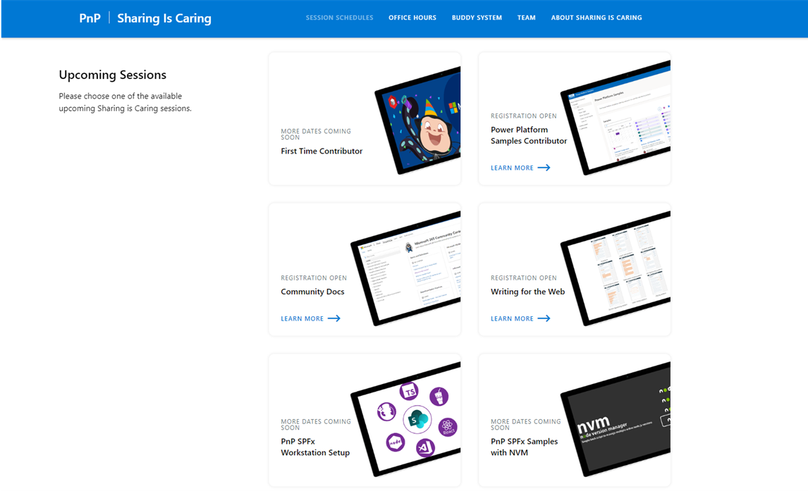
GUIDANCE
Learn how to get started in the open-source PnP community!
Upcoming Sessions:
First-time contributor
Power Platform Samples Contributor
Community Content Docs
SPFx Developer Workstation Setup
Using PnP SPFx samples w/ NVM
More than code with VS Code
First-time presenter
M365 Maturity Model Practitioners
Writing for the Web
Power Platform – Power Pages
JULY!! – New Date
https://aka.ms/sharing-is-caring
Notes:
25 Total attendees, 16 attendees who attended both First-Time Contributors and Community Docs sessions.

Slide 8





COMMUNITY
PnP Recognition Program
Showcase your contributions
Powered by Credly
More achievement levels coming soon
https://aka.ms/m365pnp-recognition
Notes:
25 Total attendees, 16 attendees who attended both First-Time Contributors and Community Docs sessions.

Slide 9
UPDATE
NEW:
Admin library GA: enumerate and manage sites + sub sites, manage apps, manage tenant settings, multi-geo support and much more
Site branding support
Support for using Search
Viva Connections dashboard editing
Throttling notifications
PnP Core SDK 1.6.0 release 🎉
aka.ms/pnp/coresdk
Update needed

Slide 10
UPDATE
Various improvements and fixes in the provisioning engine, extension methods and page transformation
PnP Framework 1.9.0 release 🎉
aka.ms/pnp/framework
Update needed

Slide 11
UPDATE
Supporting adoption and deprecation scenarios
Will replace the Modernization Scanner overtime
Initial module: SharePoint Syntex Assessment
Microsoft 365 Assessment tool 1.0.0 release 🎉
aka.ms/microsoft365assessment
Update needed

Slide 12
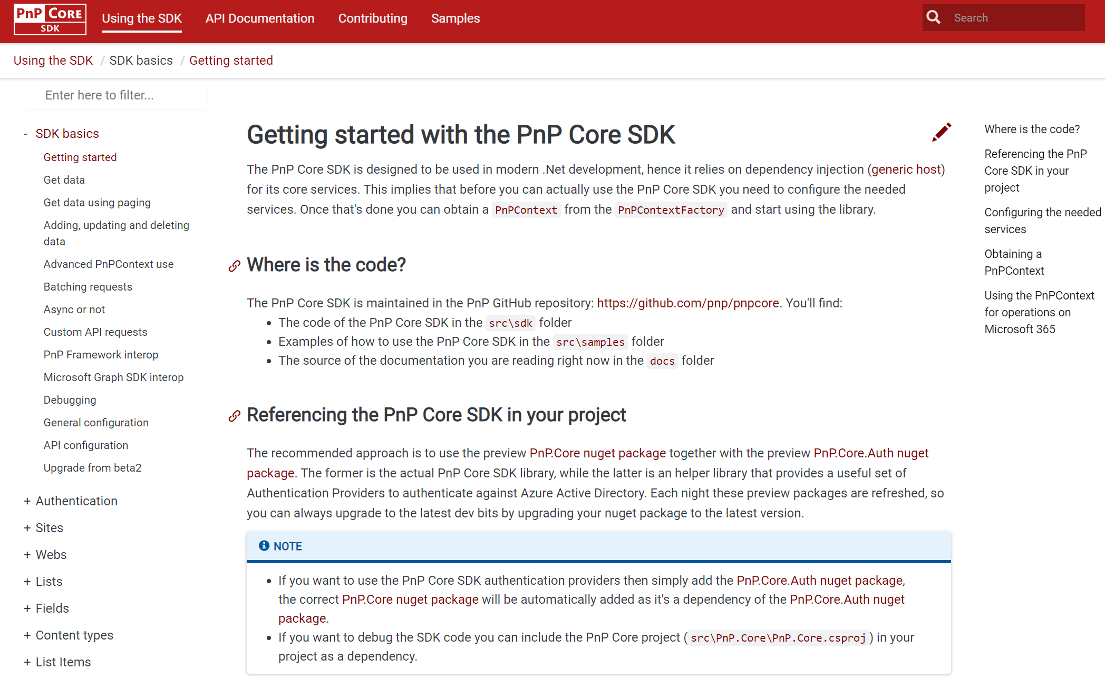
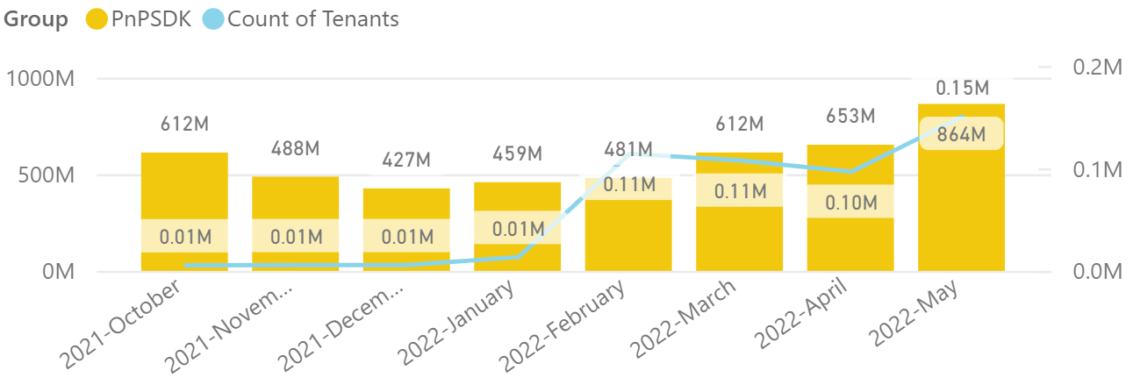
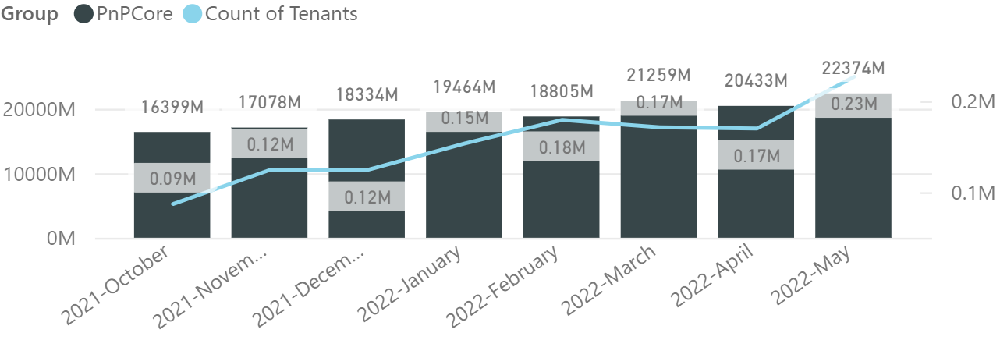

PnP .NET libraries
PnP Framework
PnP Core SDK
>220.000
tenants!
589,000 downloads!
Version 1.9.0 released!
Prepping 1.10.0 (next week!):
Merge pending PRs
General fixes and improvements: 👍 Gautam Sheth and Koen Zomers
788,000 downloads!
Version 1.6.0 released!
Prepping for 1.7.0 (next week!):
Content Type hub support, file conversions and embeddable preview links : Mathijs Verbeeck 👍💪🚀
Support for link unfurling, site and file analytics: Bert Jansen👍
Fixes and improvements: Bert Jansen 👍
Working on it
What key scenarios are still missing?
https://github.com/pnp/pnpcore/blob/dev/src/sdk/CHANGELOG.md
Roadmap
nuget.org/profiles/pnp
nuget.org/profiles/pnp
aka.ms/pnp/framework
aka.ms/pnp/coresdk

Slide 13
PnP PowerShell Open-source cmdlets which provide you an easy way to manage your SharePoint and Teams environment.

Slide 14
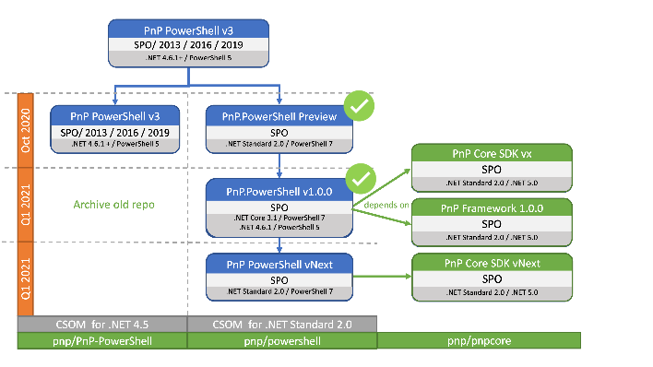
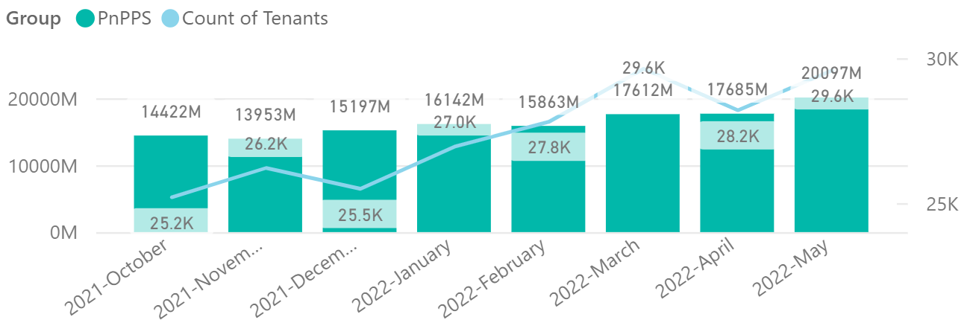

PnP PowerShell
Cross Platform PnP PowerShell
V1.10.0 released, 1.11 coming very soon !
Many updates and fixes!
2.3 million downloads!
100 million cmdlets executed per day!!
Docs shifted, no more docs.microsoft.com
Documentation, Articles and tips available at https://pnp.github.io/powershell
Thinking of dropping support for PS 5, any strong objections
PnP PS runs in PS 5, PS 7, Azure CloudShell, Azure Functions, Azure Runbooks & Raspberry Pi
New Stuff
Added Add/Get/Delete-PnPListItemAttachment for dealing with list item attachments
Added Get-PnPSensitivityLabel to get Microsoft Purview sensitivity label values
Added Add-PnPViewsFromXML to add list views from XML files .
Added Set-PnPContentType to update content type properties.
Improvements to Connect-PnPOnline, Planner cmdlets
Bug fixes and improvements continue to 1.11 release.
What next ? Would love to hear your thoughts !
>29.500 tenants!
Working on it
https://github.com/pnp/powershell/blob/dev/CHANGELOG.md
github.com/pnp/powershell
www.powershellgallery.com
PnP.PowerShell

Slide 15
yo teams Open-source Yeoman generator for Microsoft Teams development

Slide 16
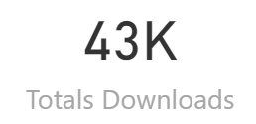
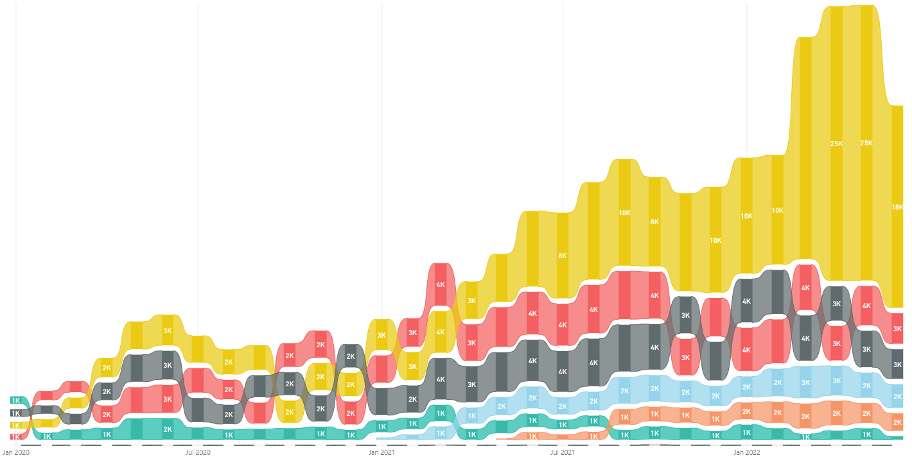
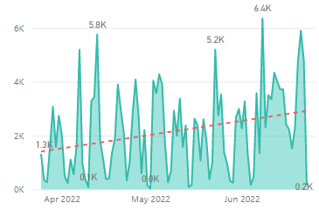
yo teams
V4 Released 🎉🎉🎉🎉
https://aka.ms/yoteams
generator-teams – The Teams apps generator
Package Downloads
📃 Docs published at https://pnp.github.io/generator-teams/
🚀 Latest release: 4.0.0 [2022-06-23]
Added `1.13` manifest Added `1.12` manifest Added `m365DevPreview` manifest Added component documentation for configuration and scaffolding details [Breaking] Upgraded Team JS SDK to version 2.0 (promises based) Updated all outdated references Manifest version 1.11 no longer selectable in scaffolding Default manifest version is 1.13 Added a warning regarding Connectors not working with Teams JS SDK 2.0 Calling bot support removed Viva Connections Tab scaffolding removed Removed individual component README files (available in Yo Teams docs) Fixed issue with telemetry timeout at the end of scaffolding
yoteams-build-core
yoteams-deploy
Daily build events
🚀 Latest release: 1.7.0 [2022-06-23]
Added support for Schema 1.13. Requires Node 14 or later Dependency package updates Fixed issue with telemetry timeout at the end of scaffolding
🔮 Preview: n/a 📅 Roadmap: ???
🚀 Latest release: 1.2.0 [2022-06-23]
Requires Node 14 or later Dependency package updates
🔮 Preview: : n/a
📅 Roadmap:
???

Slide 17
Microsoft Graph Toolkit Web Components powered by Microsoft Graph

Slide 18

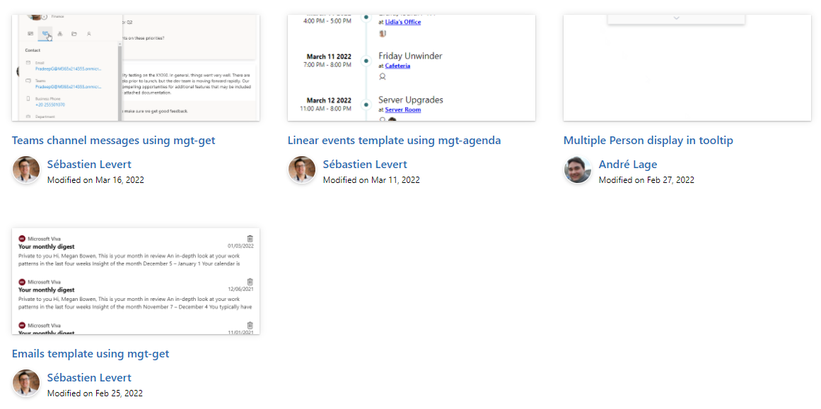

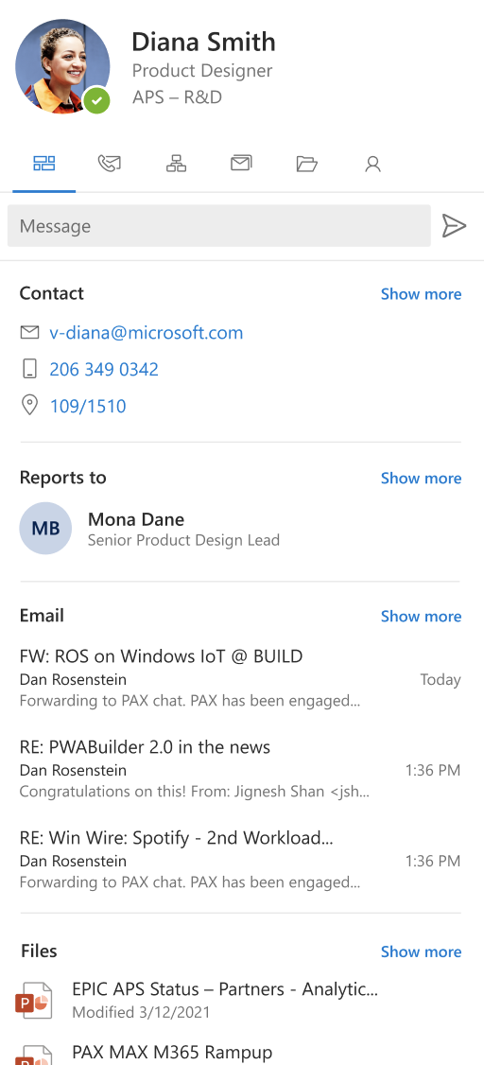
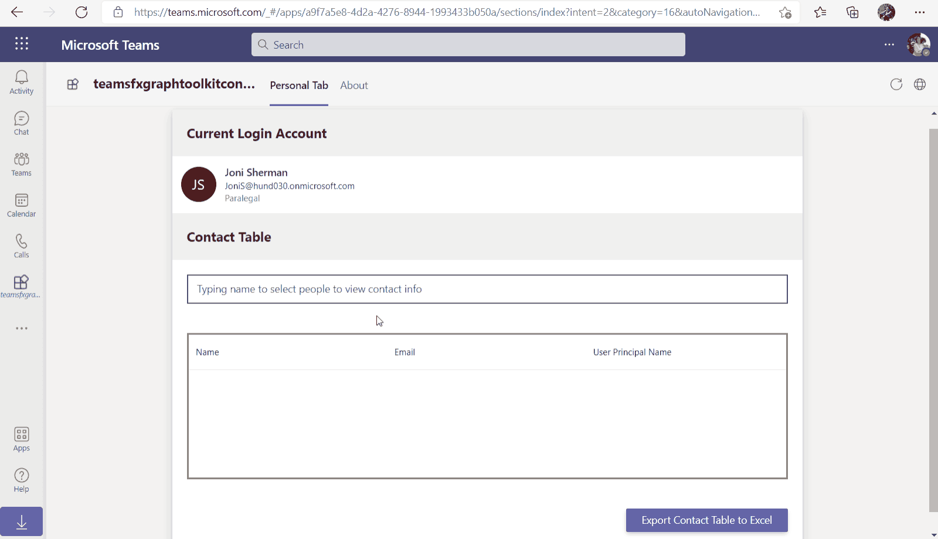
Microsoft Graph Toolkit
👀 More information: aka.ms/mgt
What’s new 🎉
The MGT samples repository is now LIVE! https://aka.ms/mgt/samples
v2.5.2 was released! Update your packages! https://aka.ms/mgt/v2.5.2
Updates to our Msal2 and Teams providers
GA release of our TeamsFx provider
Thanks @jocsch, @stniemin and @estruyf for your contributions 🎉
Our playground is now a PWA! Have a look https://aka.ms/mgt/dev
What's next? 💻
Our 2.6.0 is coming very soon! Try it now! npm i @microsoft/mgt@next
Aligning all Toolkit components to Fluent UI Web Components
More generic components and theming capabilities
We need your help ❤️
🐞 Help us fix bugs
🆕 Help us build/improve features
help-wanted & good-first-issue -> https://aka.ms/mgt/issues

Slide 19

Independent Publisher Connectors
What’s new
48 Awesome Independent Publishers!
132 Independent Publisher connectors!
4 New connectors:
Jay Jani- MS Graph Groups and Users
Mitanshu Garg- RegEx Matching
Troy Taylor- Meme
Troy Taylor- Unofficial Netflix Search
1 Update to existing connectors:
Woong Choi- GoQR (originally built by Rui Santos)
We need your help
Become an Independent Publisher by building one of these connectors: Top Connector Asks · microsoft/PowerPlatformConnectors Wiki (github.com)
Attend the next Power Platform LABs call on June 29 at 11am ET at aka.ms/PowerPlatformIntegrationLABs.
Welcome to the Community that will fuel and empower your dream towards building integration solutions! From key connector topics, such as implementing webhook triggers, to gateways- our goal is to learn together, ask questions, & provide the tools and knowledge needed to build your next integration to the Power Platform.

Slide 20
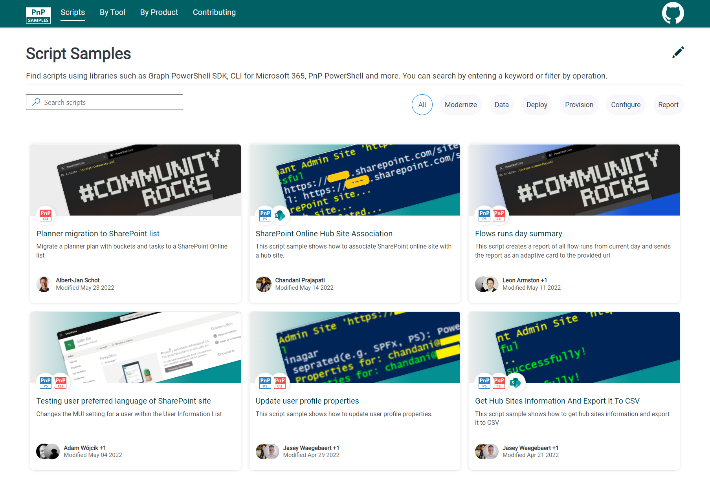

SCRIPT SAMPLES
One centralized location for all scripts for helping your day-to-day life. Contribution's welcome!
Site now has 153 scenarios and 233 scripts, using Microsoft Graph, CLI for Microsoft 365, PnP PowerShell, SPO Management Shell tooling and more…😁 AND samples integrated into "Unified" Solution Gallery
Samples Include (Bumper 2nd Edition 🤩)
New scenarios using CLI for Microsoft
Install Solution and Deploy to the SharePoint site by Nanddeep Nachan
Updated Scenarios with Power Apps PowerShell Scripts
Add/Remove users (bulk from Power Apps from CSV file by Luise Freese
Updated Scenarios with CLI for Microsoft 365 Scripts
Set Home site for SharePoint online tenant by Smita Nachan
Bulk Create Teams with JSON File by Nanddeep Nachan
Export SharePoint List Data to CSV with attachments by Nanddeep Nachan
Create bulk dummy documents, including major/minor versions by Mathijs Verbeeck
Updated Scenarios with PnP PowerShell Scripts
Delete custom color themes from SharePoint by Leon Armston
Read SharePoint List Items Using CAML Query by Jago Pauwels
We have good first issue in the GitHub Repo with sample ideas of scripts you could write – thank you Adam Wójcik! https://github.com/pnp/script-samples
Thank you for your samples and contributions! 👏
HAPPY
🎉1st🎂
BIRTHDAY!
good first issue
aka.ms/script-samples

Slide 21

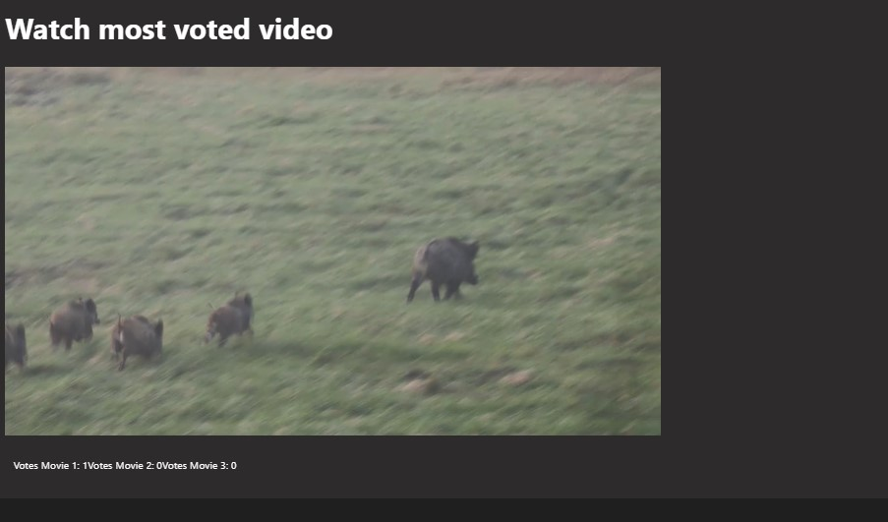
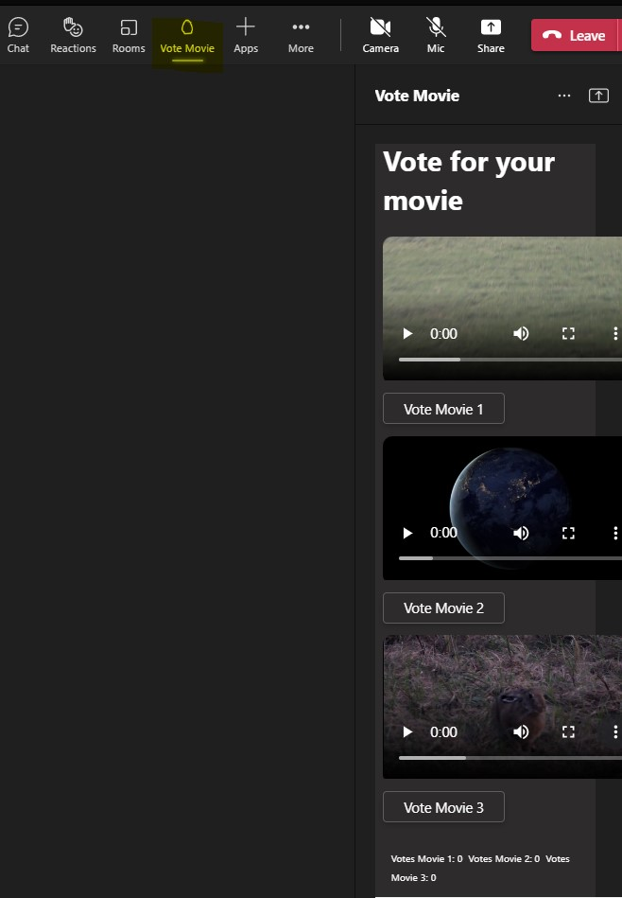
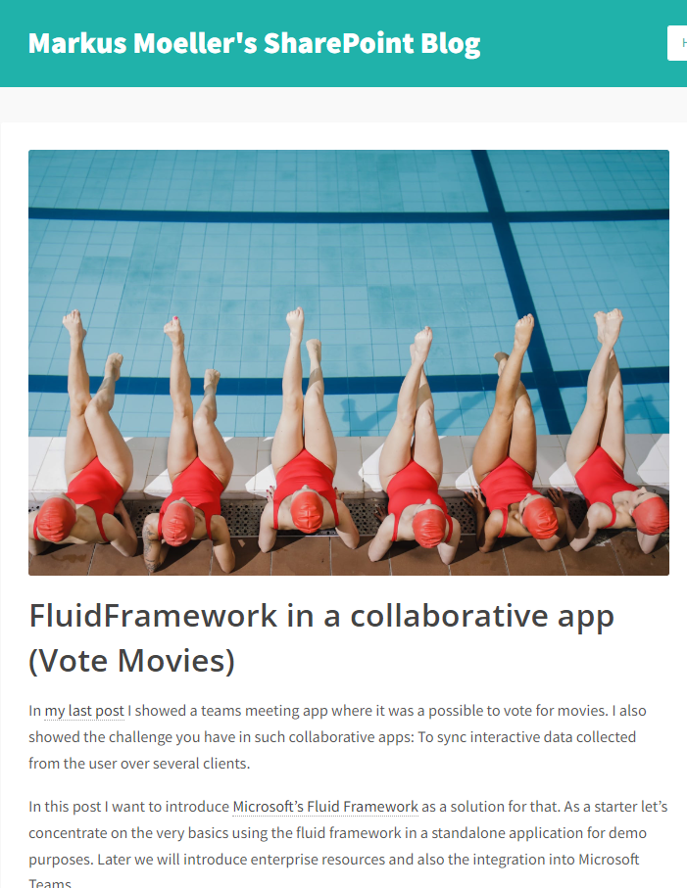








Microsoft Teams Samples
Watch and vote for movies in a Teams meeting!
Meeting app with sidebar and stage view
Vote and watch movies together
Uses Fluid Framework
Detailed blog article https://mmsharepoint.wordpress.com/
SAMPLES WANTED!
https://aka.ms/tab-meeting-stageview-vote-movie
Many thanks to Markus Moeller (@Moeller2_0) for yet another amazing sample!
Check out all the samples! https://aka.ms/m365-samples
Teams samples w/filtering https://aka.ms/teams-samples
Got a cool Teams app to share?
Please contribute – or make use of the samples yourself!
All the samples are at https://aka.ms/m365-samples
Teams samples w/filtering https://aka.ms/teams-samples
Notes:
Wajeed Shaikh – Teams PM

Slide 22

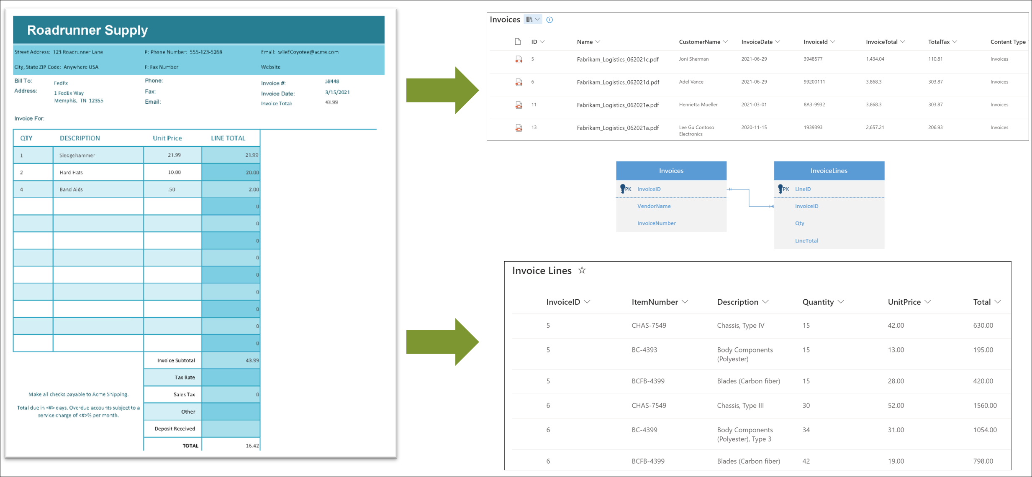


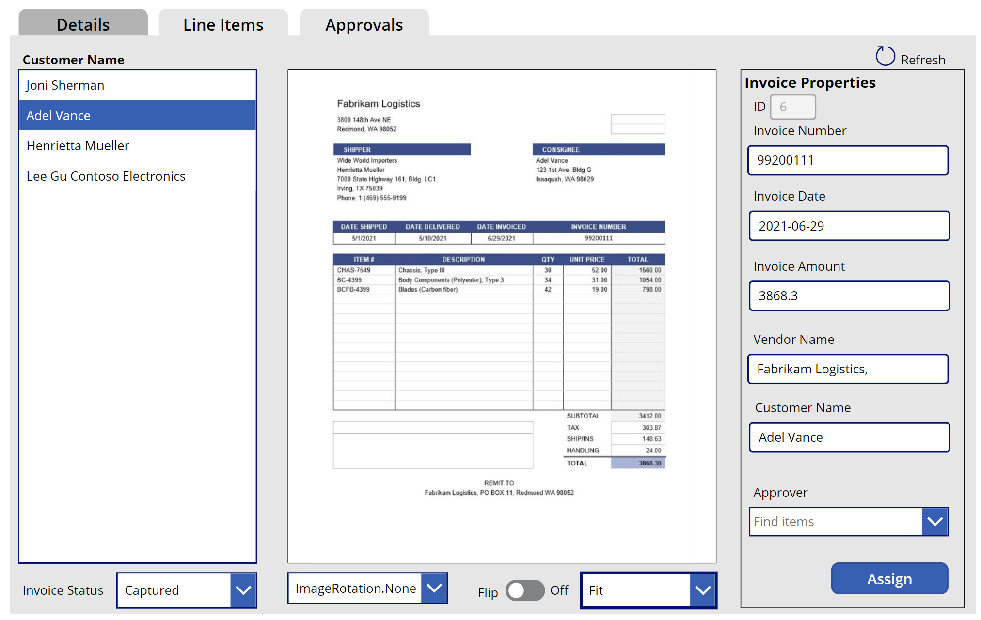
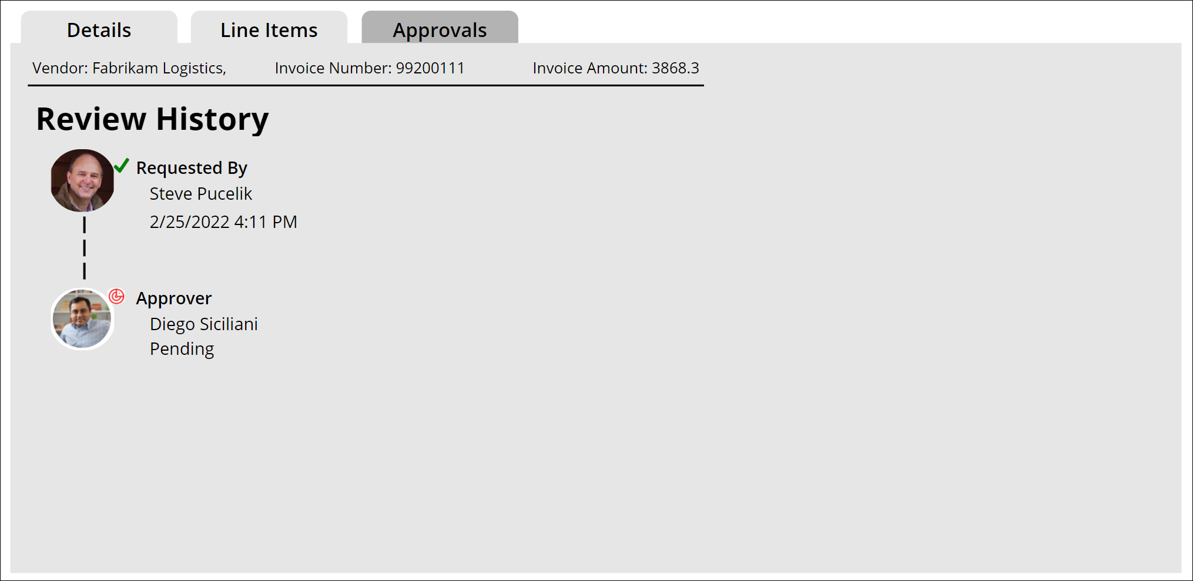
Power Platform Samples
New:
Invoice Automation using the SharePoint Syntex Steve Pucelik | Spucelik
Update needed
Join the Power Platform Contributors
Sharing is Caring Session – May 9th
aka.ms/powerplatform-samples ​
Notes:
These are the updates that we processed since out last call.
New samples:
- Power Automate: SharePoint Collect Feedback April Dunnam | @aprildunnam Demonstrates:
Executing a Flow from a SharePoint Library with input parameters
Leveraging the custom responses option in Power Automate approvals
https://github.com/pnp/powerautomate-samples/tree/main/samples/sharepoint-collect-feedback
- Power Automate: Get Graph API Data within Power BI Reports Scott McKenzie | @365EDUBI Enables Graph API data to be refreshed within the Power BI Service. https://github.com/pnp/powerautomate-samples/tree/main/samples/graph_api_in_power_bi
Updated samples:
Power App: Fluent UI Custom Theme Fabio Franzini | @franzinifabio Fixed datepicker control theme https://github.com/pnp/powerapps-samples/tree/main/samples/fluentui-custom-theme
These latest samples should show within 24 hours

Slide 23
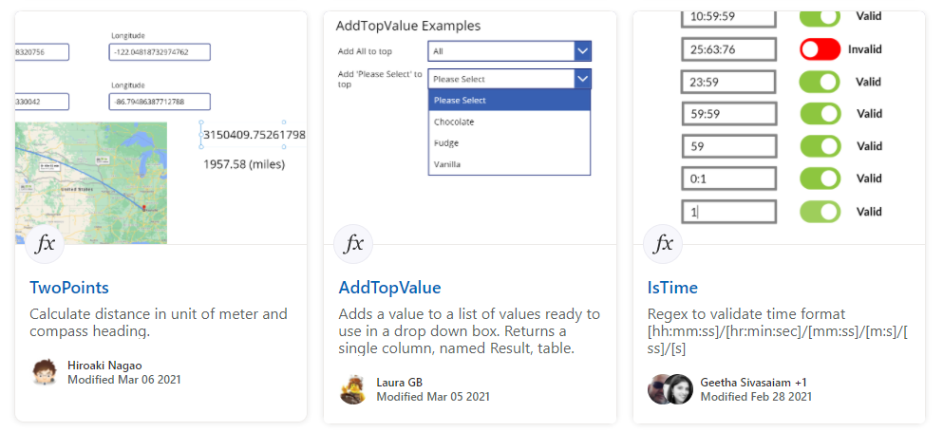
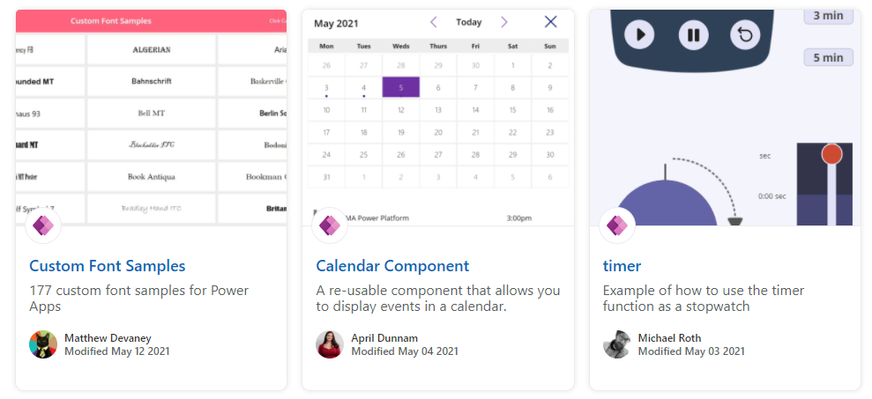
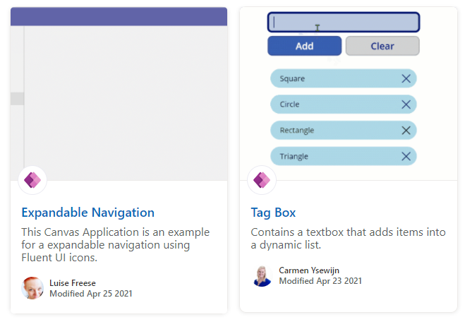
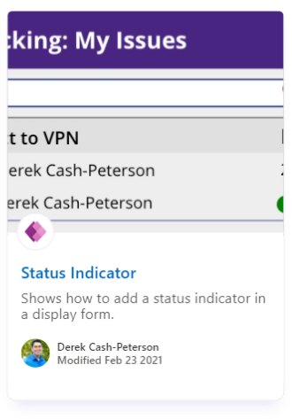
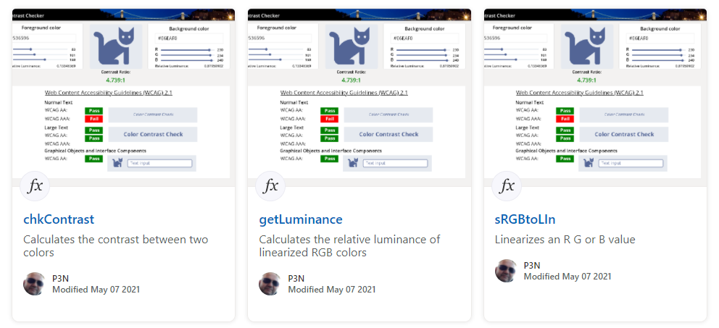
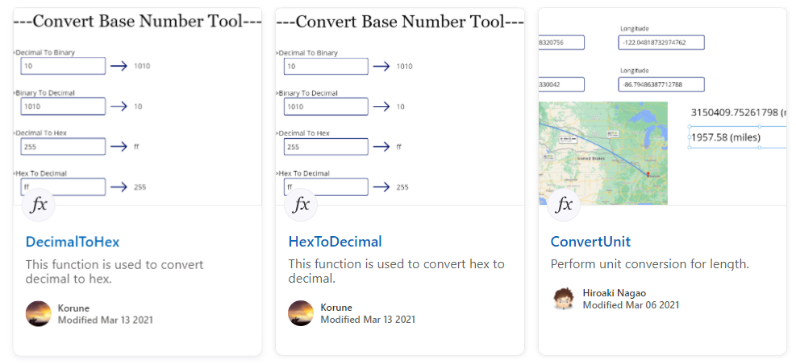
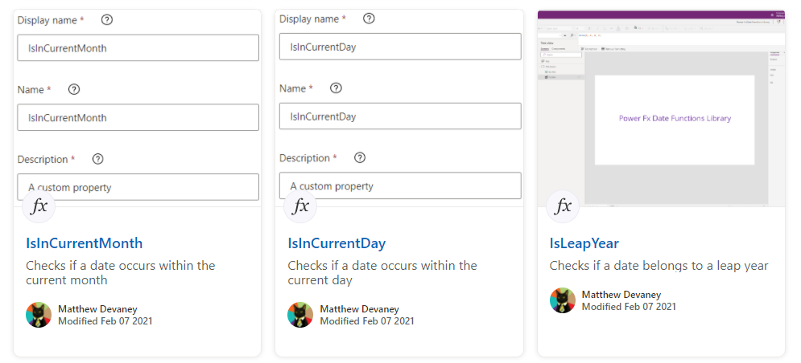
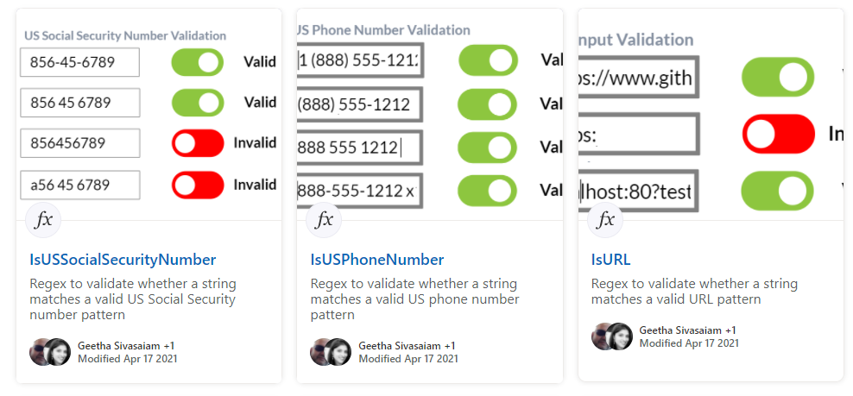
Power Platform Samples
aka.ms/powerplatform-samples ​
Power Apps templates​
Power Apps components​
Power Apps connectors​
Power Fx Custom Functions
Power Automate flow templates​​
PowerBI​​
Power Virtual Agents​​
Join the Power Platform Contributors
Sharing is Caring Session – Wednesday June 29th

Slide 24


Optional picture time!
Video on and we’ll grab a Together Mode pic with those who are willing to do this.
We are together on this as a community!
By enabling your camera for the picture, you’ll give us the permission to share your picture in social media.

Slide 25
DEMO
List Formatting - Tab and Percentage Chart – André Lage
Keep track of your activities with Microsoft Lists and Power Automate – Federico Sapia
Build your own Microsoft Teams using Microsoft Graph Toolkit and .NET Core API and Integrate using Web Components – Sohil Bhalla

Slide 26

Q&A

Slide 27
Thank you
Recording will be available in 24 hours on
Microsoft 365 Community (PnP) YouTube channel
https://aka.ms/m365/videos
(subscribe today)
Follow us on Twitter
@Microsoft365Dev | @M365PnP
Next M365 General Dev call: July 7th at 07:00am PT
Next Viva Connections & SharePoint Framework call: June 30th at 07:00am PT
See all other community calls from https://aka.ms/m365/calls

Slide 28



Slide 29
Thank you

